Slide 1
Research Methodology- Unit 5 DATA COLLECTION AND ANALYSIS
Prime College- BIM 6th Semester

Slide 2
Research Methodology- Unit 5 Chapter 6- Statistical Analysis-Descriptive Data
Prime College- BIM 6th Semester

Slide 3


Learning Outcome 1
Inferential Statistics & Inferential Analysis
- Concept
Z-test, t-test etc.
Validity and Reliability testing

Slide 4
Inferential statistics
We use inferential statistics to make inferences from our data to more general conditions;
Eg: t-test, Analysis of Variance (ANOVA)
We use descriptive statistics simply to describe what's going on in our data.
Eg: Mean, Median, Normality

Slide 5
Inferential Statistics
Sample
Sample
Population
Sample
Types of inferential statistics
Parametric
T-tests
ANOVA
Correlation
Multiple regression
ANCOVA
Non-parametric
Chi-Square
Sample
Inferential statistics are used to draw conclusions about a population by examining the sample

Slide 6
Inferential Statistics
inferential statistics attempt to make an inference about the data.
Inferential statistics are the statistics that help to establish relationships among variables to draw valid conclusions.
Inferential statistics can further be categorized into two categories:
a) Parametric statistics and b) non-parametric statistics.

Slide 7
Parametric statistics
Parameter’ means a population value.
If all the scores of a defined population are available and a mean is calculated, this mean is a parameter.
Statistic, however, means a measure calculated from a sample. In the literal meaning, a parametric statistical makes assumptions about the parameters (defining properties) of the population distribution(s) from which one’s data are drawn.
Importance
Assumption of Normality
Homogeneity of variance
Continuity and equal intervals of measures

Slide 8
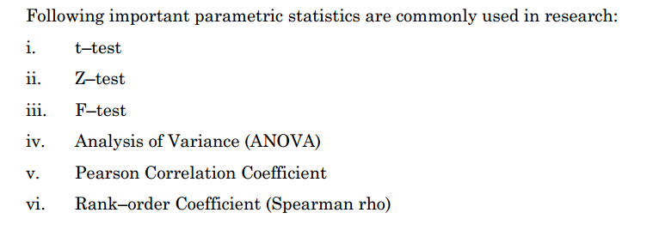
Methods of Parametric Statistics

Slide 9
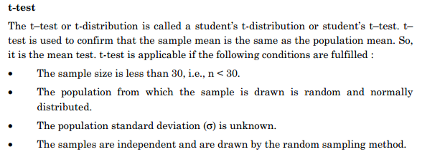
T-Test

Slide 10
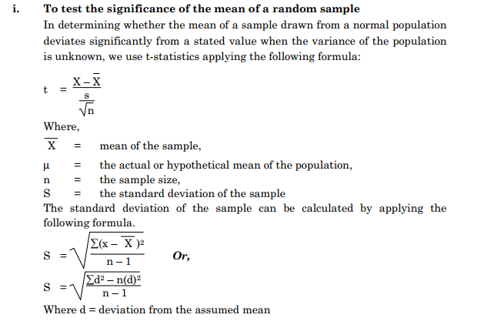
Application of T-test

Slide 11
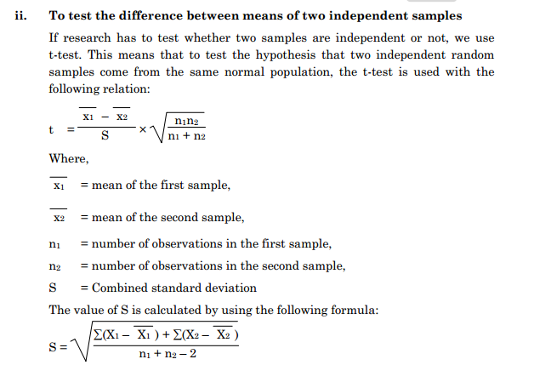
Application of T-test

Slide 12
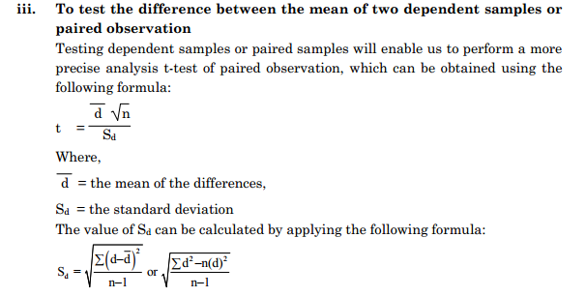
Application of T-test

Slide 13
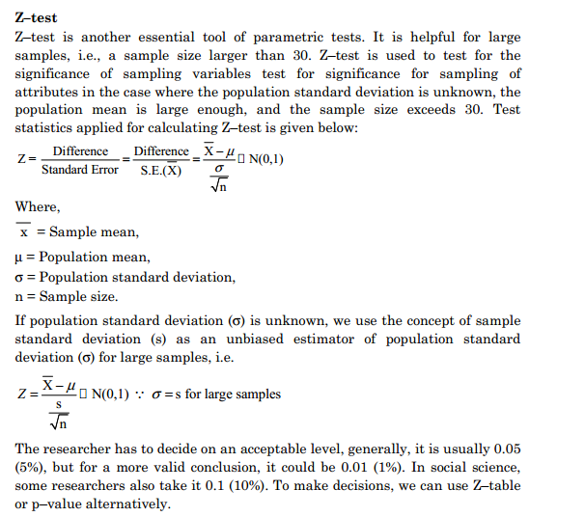
Z- Test

Slide 14
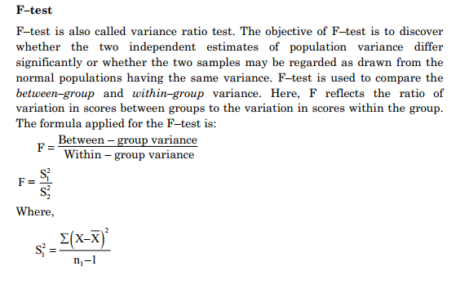
F- Test

Slide 15
Analysis of Variance (ANOVA)
This tool was developed by the famous statistician R.A. Fisher.
It consists of classifying and cross-classifying statistical results and testing whether the means of a specified classification differ significantly.
As we discussed earlier about the t–test and F–test, these tests are not applicable when more than two means are involved.
This is a method of testing the equality of three or more population means by analyzing unbiased estimate of population variance.
It can be One–way ANOVA, Two–way ANOVA, and multi–way ANOVA.

Slide 16

Karl Pearson's correlation coefficient
This method was developed by Karl Pearson, hence called the Karl Pearson correlation coefficient and denoted by ‘r’.
This is a statistical method of analyzing the relationship between variables.
This test helps us to assess the strength of the relationship between the variables.
The value of ‘r’ ranges from +1 to –1. Interpretation of the relationship is made based on the Karl Pearson correlation coefficient:
▪ If r = +1, there is a perfect positive correlation between the variables.
▪ If r = –1, there is a perfect negative correlation between variables.
▪ If r = 0, there is no relationship between the variables.
▪ If r is closer to +1, generally more than 0.6, there is a high degree of positive correlation.
▪ If r is closer to –1, there is a high degree of negative correlation between variables.
Karl Pearson's correlation coefficient can be calculated by using the following
formula:

Slide 17

Rank–order coefficient
Rank–The order coefficient is also called Spearman rho and denoted as ‘U’.
It is helpful in qualitative attributes having ordinal scale data like beauty, intelligence, honesty, etc.
If measured in order, i.e., ordinal scale, rank order correlation, data becomes more suitable compared to the Karl Pearson correlation coefficient.
The value also ranges from +1 to –1, and the interpretation can be the same as in the Pearson coefficient.
Spearman rho can be calculated by applying the formula:

Slide 18
Non-parametric statistics
Non–parametric statistics are applicable if the data are collected on nominal or ordinal scales.
As these statistics do not make any assumptions regarding population distribution, they are also called the distribution-free method.
Non–parametric methods are the statistical methods that are not concerned with the estimation or testing of a hypothesis for one or more parameters of probability distribution functions.
Also known as parametric–less tests.
Non–parametric statistics are based on the following bases:
 The sample size is less than twenty.
 No assumptions are made regarding the population distribution from where the sample is drawn.
 The hypothesis does not involve a parameter of the probability function of the population.
 Measurement of variables is at most ordinal.

Slide 19
Chi-square Test: Goodness of Fit and Independence of Attributes; and Statistical Testing of Hypothesis
Statistical Testing Hypothesis
The hypothesis is the testable statements that are claimed with setting research objectives.
It is a picture of research results estimated by the researcher, which can be tested with the application of various inferential statistics.
Setting up and testing a hypothesis is, thus, an essential part of statistical inference. Hypotheses are tested based on analysis of the sample.
Hypotheses are tested based on probability value (p-value), though in many cases, table value and computed values are compared to decide regarding acceptance and rejection of the hypothesis. p-value is the numerical measure of the statistical significance of a hypothesis test.
For testing the hypothesis based on the p-value, the researcher should first decide the significance level or confidence interval.
For instance, if the confidence level is set to 5%, then the p-value having less than 0.05 provides evidence to reject the hypothesis.
If the p-value is more significant than 0.05, there will be sufficient evidence to accept the null hypothesis.

Slide 20
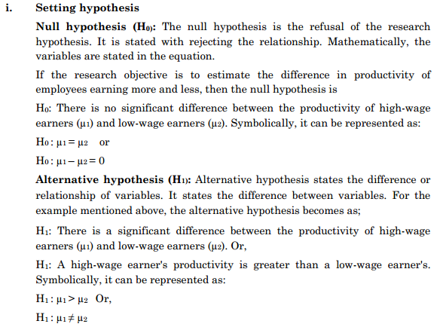
Procedure in testing hypothesis

Slide 21
Procedure in testing hypothesis
ii. Test statistic:
The test statistic is the formula to compute the value used in decision-making. Do not substitute any values into this formula at this step.
State the formula for test relevancy and whether it may fit a parametric or non-parametric test.
iii. Level of significance:
State the significance level for the test.
iv. Calculation:
Substitute the sample data into the formula given for the test statistic and obtain a test statistic value.
This step is often performed by using computer software or manual. Copy the value from the computer output and put it here.

Slide 22
Procedure in testing hypothesis
v. Decision:
State your decision about the null hypothesis. It will either reject H0 or fail to reject H0.
vi. Conclusion:
There is (or is not) sufficient evidence to indicate that (followed by the English version of the research hypothesis) to reject (or fail to reject H0) indicating that the productivity of high-wage earner and low-wage earner is not significantly different (or significantly different).

Slide 23
Errors in hypothesis testing
Type I Error:
In hypothesis testing, type I error can be denoted by alpha (α) and spelled as α-error. In this type of error, we may reject H0even if H0is true.
The probability of type I error is usually determined in advance and is understood as the level of significance of the testing hypothesis.
If the type I error is fixed at 5 percent, there are about five chances out of a hundred that we will reject H0when H0is true.
Thus, we can control type I errors by fixing their significance level as low as possible.

Slide 24
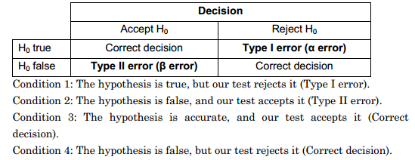
Errors in hypothesis testing
ii. Type II Error:
Type II errors may be encountered in hypothesis testing if we accept H0when H0 is invalid. Type II error is denoted by beta (β) and spelled as β–error.
When we try to reduce type I error in a fixed sample size, the probability of committing type II error increases.
One of the limitations is that both types of errors cannot be minimized simultaneously; hence there is trade–off between the two types of errors.
Thus, testing the hypothesis, it is recommended to make a possible effort to maintain an appropriate balance between type I and type II errors.
Types of errors while testing the hypothesis can be presented in tabular structure as below:

Slide 25
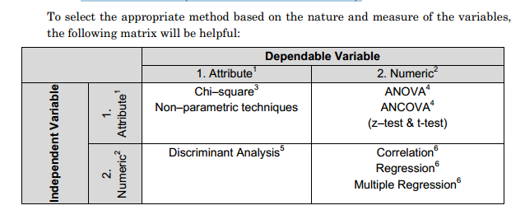
Selection of Statistical Methods
Before selecting the methods, we should be aware of the following factors:
i. Variables: Independent variable and Dependent variable
ii. Measure of variables: Numeric measure (interval and ratio scale data) and Attribute measure (nominal and ordinal scale data)

Slide 26
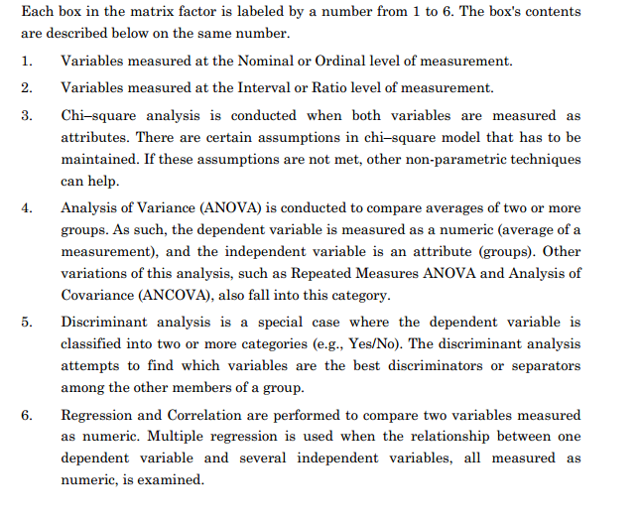
Selection of Statistical Methods

Slide 27
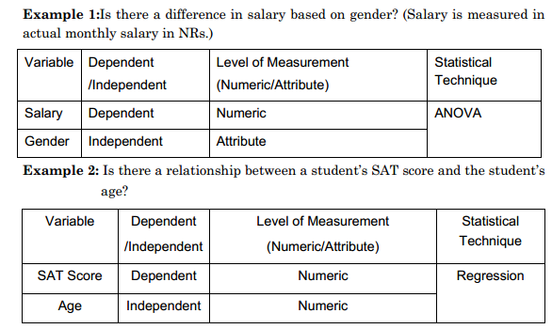
Selection of Statistical Methods

Slide 28
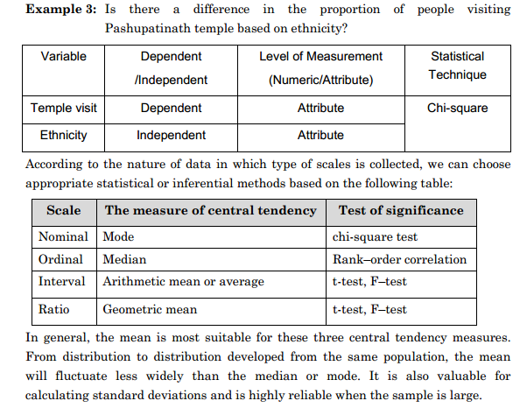
Selection of Statistical Methods

Slide 29
End of Chapter 7
(Click the arrow when in Slide Show mode)
Notes:
In Slide Show mode, click the arrow to enter the PowerPoint Getting Started Center.

